Slide 1

Car Prices Prediction
RIDWAN WIDYA ADI PRASETYO
(DS 18)

Slide 2
Table of contents
01
Background & Data Understanding
02
Exploratory Data Analysis
03
Modelling with Linear Regression - RFE

Slide 3
Background & Data Understanding
01
You can enter a subtitle here if you need it

Slide 4
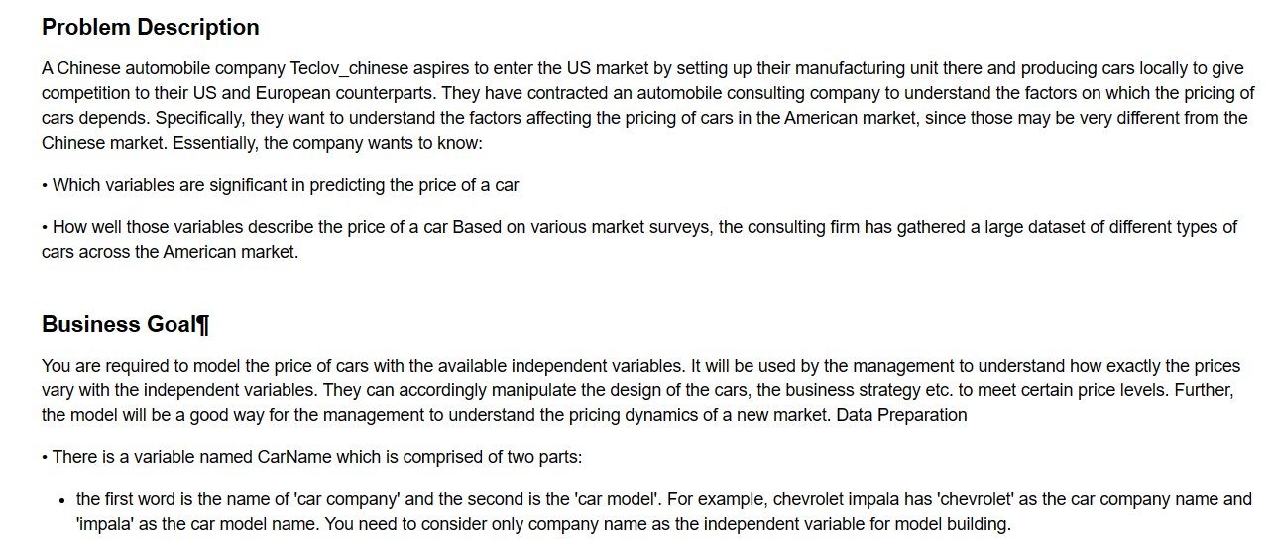
Background

Slide 5
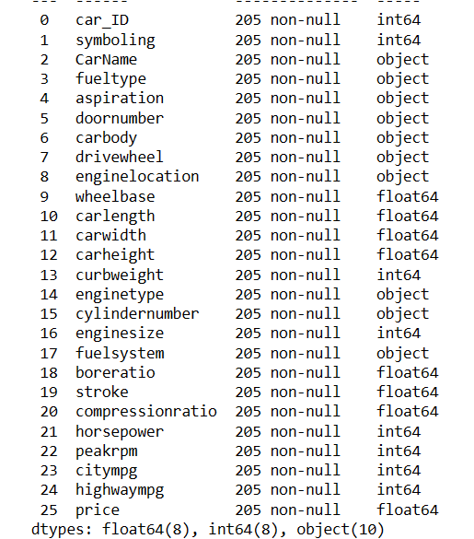
Data Understanding

Slide 6
Exploratory Data Analysis
02
You can enter a subtitle here if you need it

Slide 7
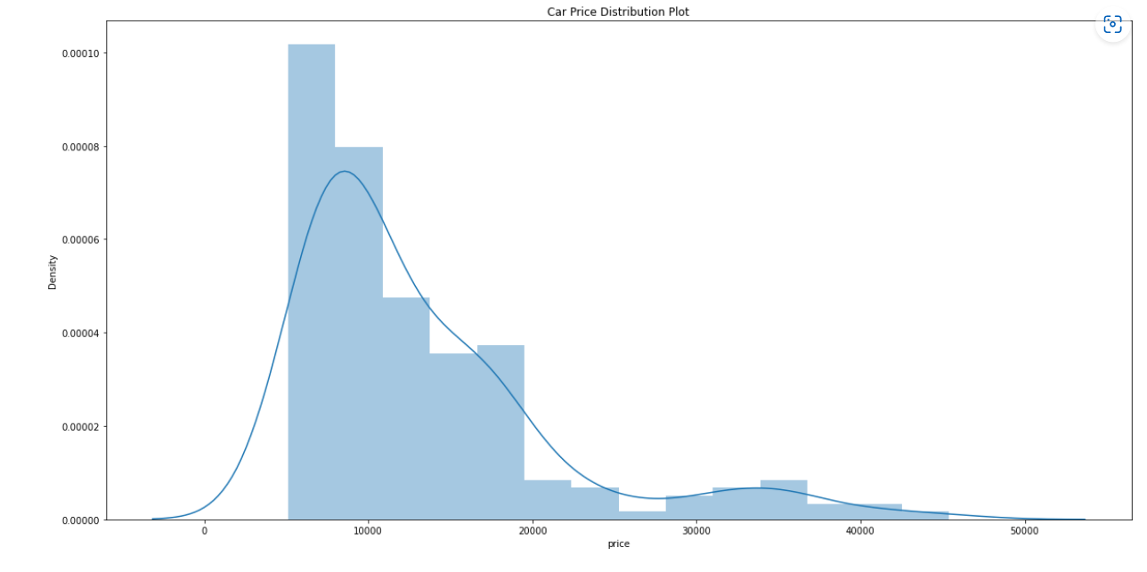
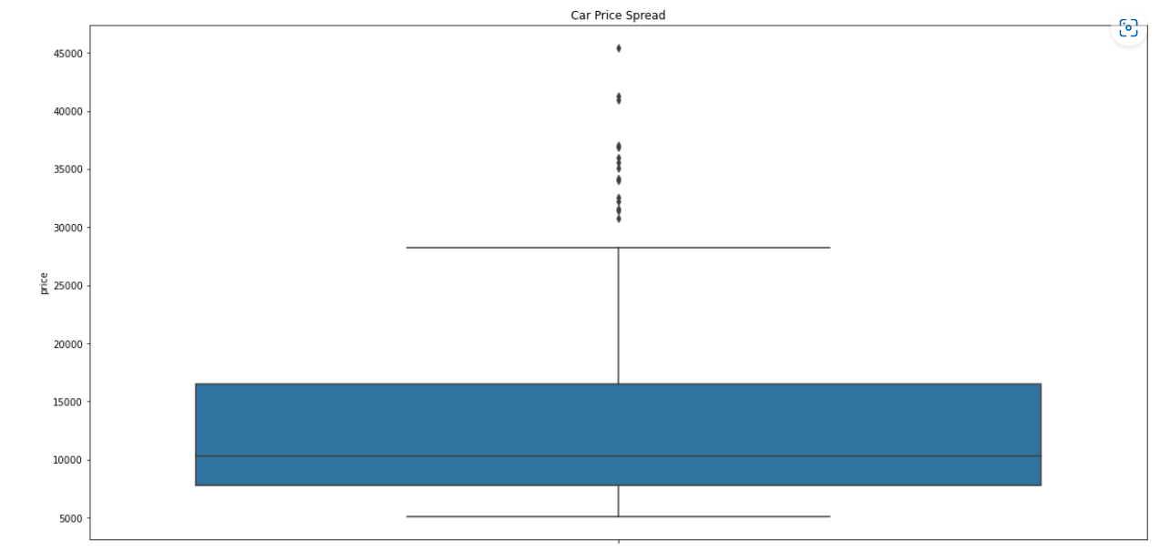
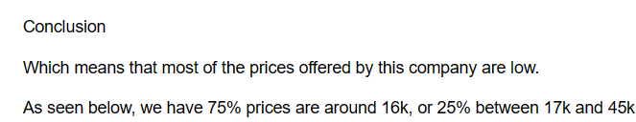
Overview Price Summary Distribution

Slide 8
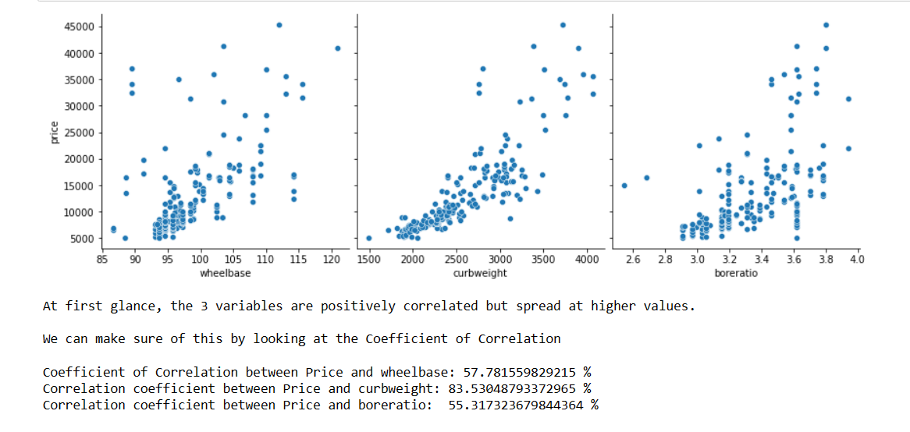
EDA (Price vs Individual Variabel)
1. EDA (Price VS Wheelbase - curbweight - boreratio)

Slide 9
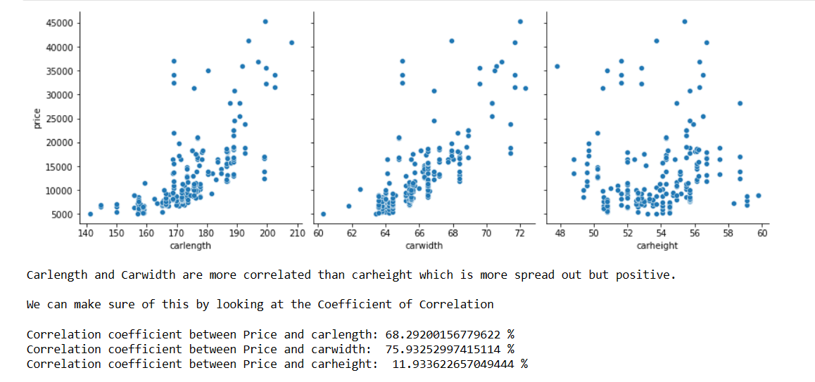
EDA (Price vs Individual Variabel)
1. EDA (Price VS carlength - carwidth - carheight)

Slide 10
EDA (Price vs Individual Variabel)
2. EDA (Price VS carlength - carwidth - carheight)

Slide 11
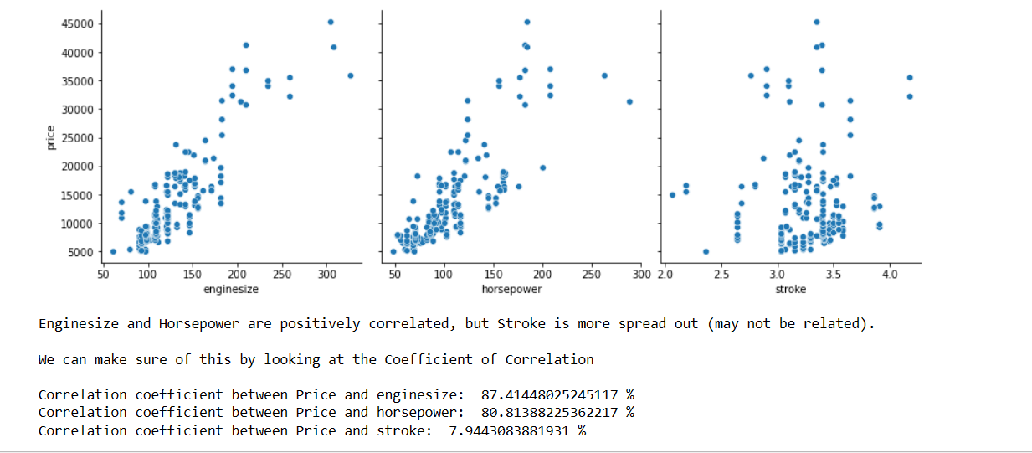
EDA (Price vs Individual Variabel)
3. EDA (Price VS carlength - carwidth - carheight)

Slide 12
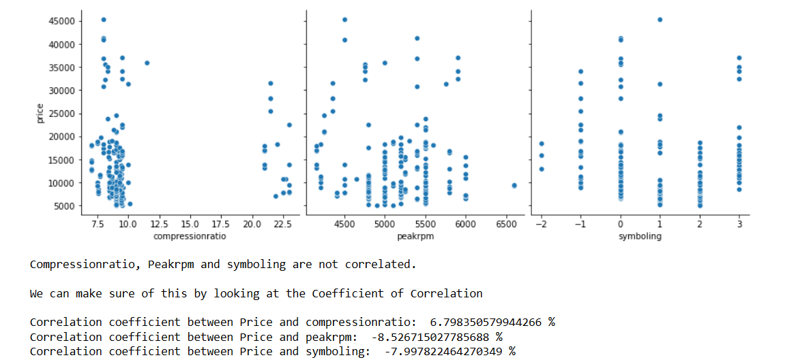
EDA (Price vs Individual Variabel)
4. EDA (Price VS compressionratio - peakrpm - symboling)

Slide 13
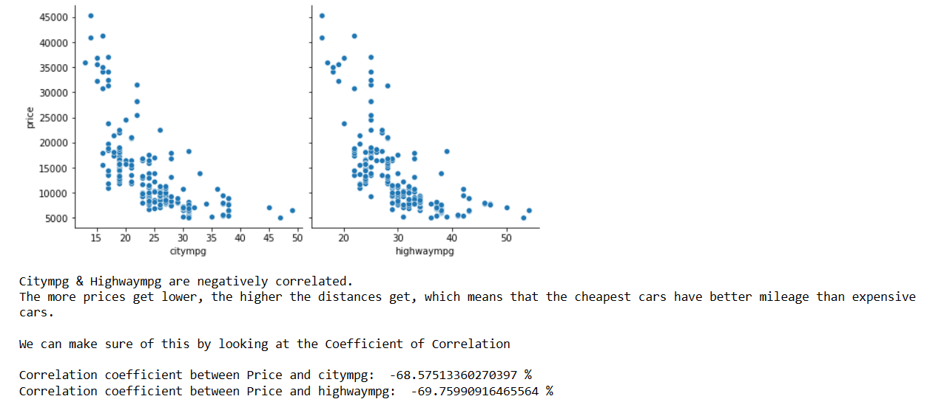
EDA (Price vs Individual Variabel)
4. EDA (Price VS compressionratio - peakrpm - symboling)

Slide 14
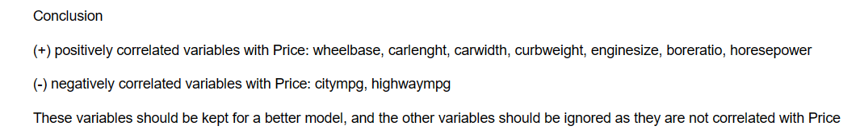
EDA (Price vs Individual Variabel)

Slide 15
Modelling
03
You can enter a subtitle here if you need it

Slide 16
Data Preparation & Preprocessing
Remove the uncorrelated variables with Price, and choose only one variable among the variables correlated with it
('carheight' ,'stroke' ,'compressionratio' ,'peakrpm' ,'carlength' ,'carwidth' ,'curbweight' ,'enginesize' ,'highwaympg’)
2. Encoding selection column (fueltype,suction,doornumber,enginelocation)
3. One hot encoding for the rest

Slide 17
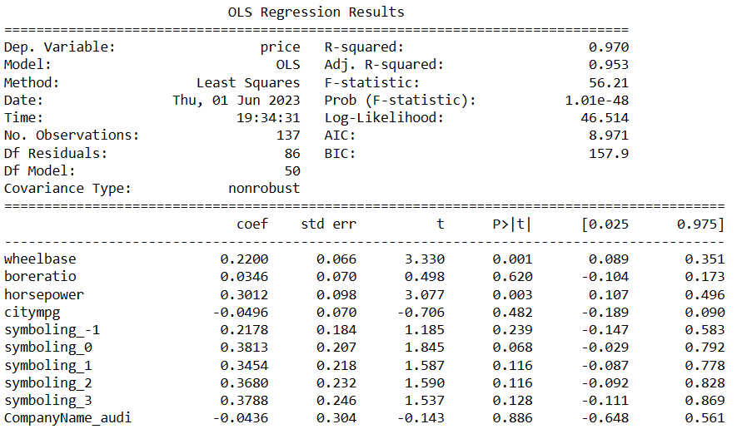
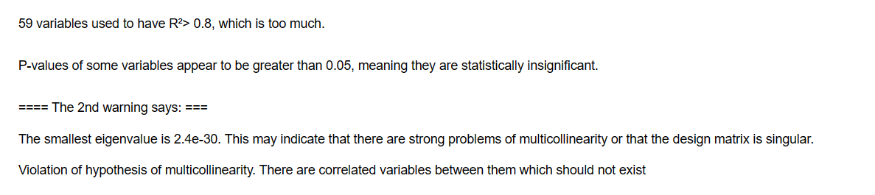
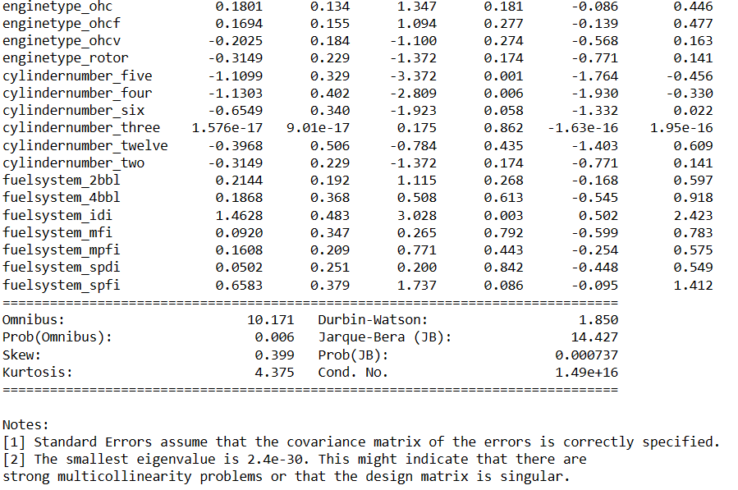
Data Modelling Linear Regression Non RFE

Slide 18
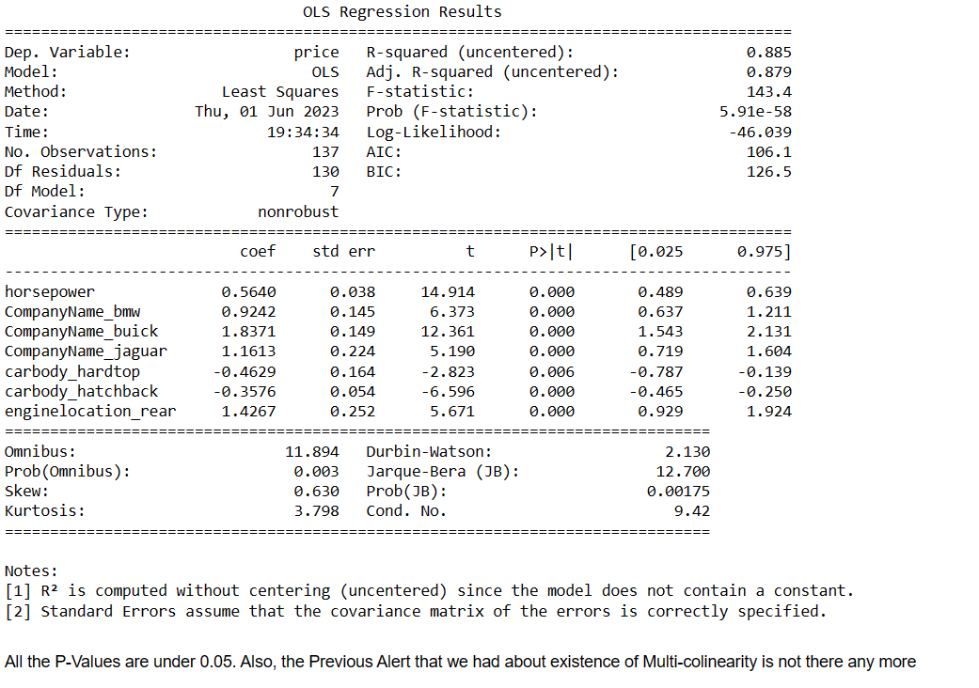
Data Modelling Linear Regression with RFE

Slide 19
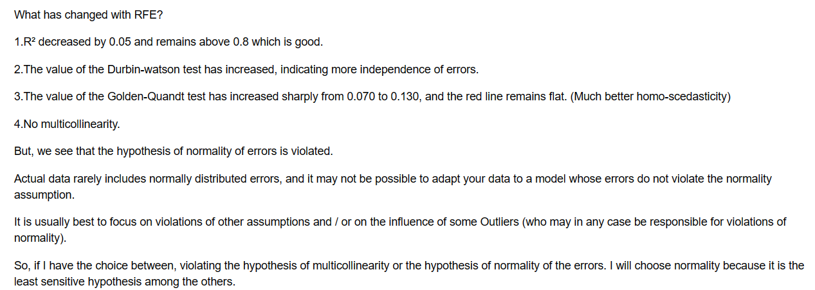
Conclusion

Slide 20
Thanks!

